Slide 1
Colour TV
A television uses light to make a picture.

Slide 2
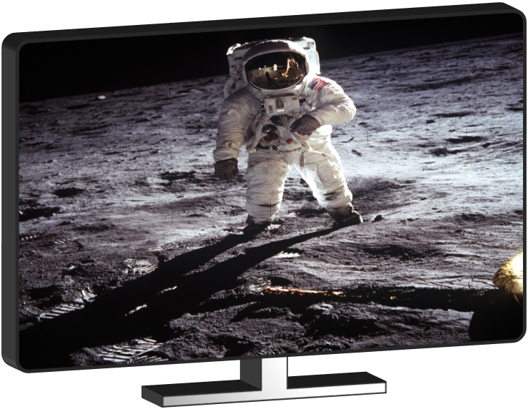
Colour TV
How does a TV use light to make a picture?
A TV picture is made up of thousands of tiny coloured lights
All the colours on a TV are made by mixing just three colours of light
Mixing red and green light makes the same colour as mixing red and green paint

